Slide 1
Securing the computer through an external USB device
A.Sai Karthik -B150310CS
T.Mahesh Kumar -B150588CS
K.Sai Manoj -B150610CS

Slide 2
Abstract :
In this project we modified the Linux kernel boot process to require that a user, as a part of authentication process, insert a USB device to boot into the computer.
If the user failed to provide the correct USB device the machine process would halt the machine to boot into the computer
To prevent brute-force attacks we have also added an additional feature which lets a user try different USB’s to a maximum of 5 attempts or a configurable timeout(100 sec).

Slide 3
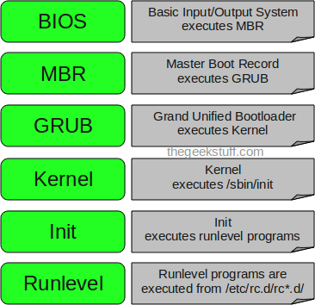
Understanding the boot process:
We modified the drivers/usb/core/hub.c file to add the conditions for number of attempts.
We also modified the main.c file in the init section of the kernel code so that we can request for an external USB device with a uniquely identified key to be put into the USB port(User space authentication).

Slide 4
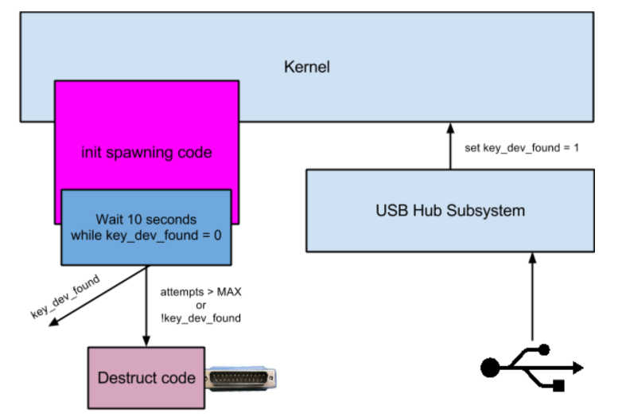

Slide 5
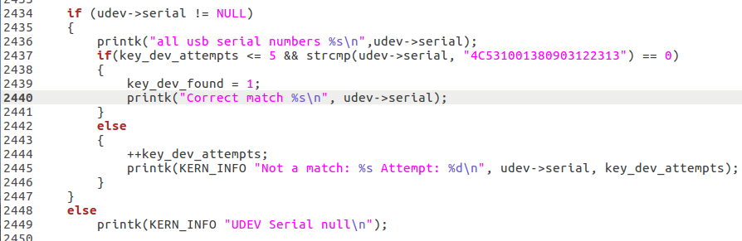
Modifying the code in hub.c of USB drivers kernel code
The above code sets the global variable key_dev_found to 1 and lets the boot process complete if the USB device with correct serial is inserted within the specified number of attempts and the time constraint.

Slide 6
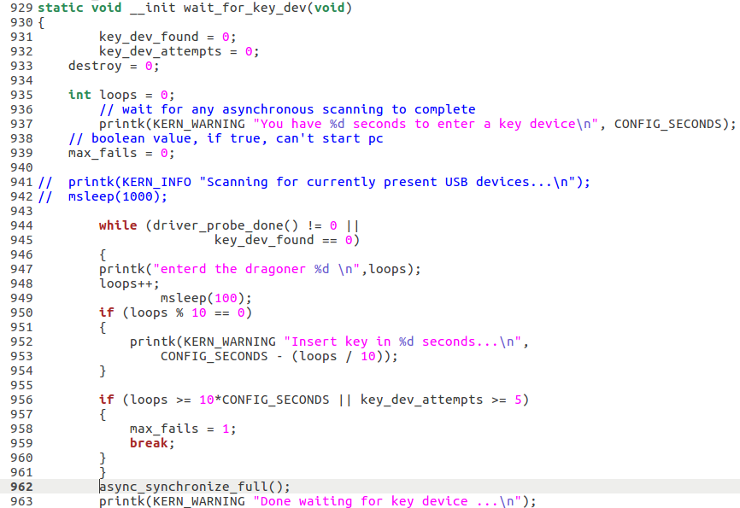
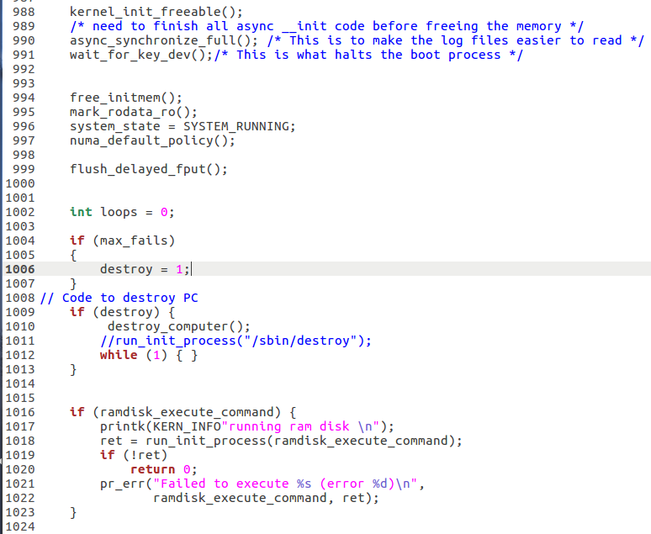
Modifying the code in main.c of init process

Slide 7
Compiling and Testing the kernel
To use our new system call we should first recompile the kernel.For this use the following the commands-
sudo make -j 4
sudo make modules_install -j 4
sudo make install -j 4
sudo update grub
Restart the system after the above process.

Slide 8
THANK YOU

